Slide 1
Stages of Labour
Notes:
NOTE: Refer to module outline for goal, objectives, class outline, equipment, resources required and references.
If this is the first class:
Welcome participants to class.
Housekeeping: bathroom, breaks, length of session, ground rules/respect.
Have participants introduce themselves (name, due date, HCP, anything they would like to share about the pregnancy).
Provide an outline of topics to be discussed.
Provide the choice of prenatal handout (depending on your organization, this may be Healthy Beginnings or A Healthy Start for Baby and Me) for each expectant mother.
Provide a list of community resources.
Suggestion for Facilitator: on a flip chart, list the topics to be discussed in this session.
Getting ready
Events of late pregnancy
True, false/pre-labour or preterm labour?
Stages of labour
When to go to the hospital

Slide 2
Brain Buster
Notes:
Suggested Activity: Prenatal Fun
Please note that this may not be appropriate for participants with low-literacy or if English is not their first language.
The purpose of this activity is to:
Familiarize participants with the terminology of labour and delivery.
Encourage the pregnant woman and her partner to start thinking and working together as a team, as they prepare for labour and delivery.
Provide a pencil and a copy of the Prenatal Fun brain buster activity (in Module Outline) to each couple and allow 5 minutes to solve the puzzles. Ask participants to volunteer the answers (see answer sheet).

Slide 3
Getting Ready for Your Baby
Notes:
The last few months of pregnancy are a time when pregnant women and their partners begin preparing for labour and delivery and the arrival of their new baby.
Here are some suggestions to consider:
Ensure prenatal education is completed at least a few weeks before your due date. Learn as much as possible about labour, delivery and breastfeeding.
Discuss any questions or concerns around labour and delivery with your health care provider.
Discuss and update as necessary your birth plan with your healthcare provider and support team. Decide who will support you during labour and delivery (partner, doula, friend, etc.).
Attend a hospital information session and tour. A pre-registration component may be part of the hospital session.
Make a list of baby items that you will need and buy a few at a time. Ask family or friends if they have items that you can borrow.
Talk to other mothers about their experience with labour, birth, and the first few weeks at home with a new baby.
Make arrangements with your employer about taking time off work for maternity or parental leave.
Arrange for family and friends to help out during the first few weeks at home.

Slide 4
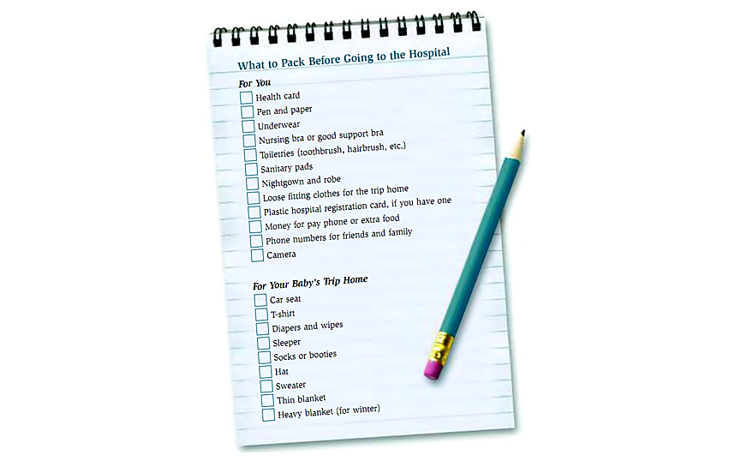
What to Take to the Hospital
Notes:
Pack your suitcase 3-4 weeks before your due date. Your local hospital or birthing centre will provide you with specific information about what you need to bring. You may also want to include the following items:
Pillow with brightly coloured pillow case.
Lip balm.
Warm socks.
Drinks and snacks.
Cotton sanitary pads.
Newborn diapers (many hospitals don’t provide these).
Music.
Lotions or massage oils.
Microwavable heating pad or hot water bottle.
Take a tour of your hospital or birthing centre prior to your delivery date. This will provide an opportunity to see the labour and delivery unit and to learn about specific policies and procedures. For example, some hospitals want you to contact them prior to arriving in labour.
Partners need to pack a ‘Partner’s kit’ as well. It may include snacks, a toothbrush, change of clothing, cell phone, pyjamas, and a swimsuit.
If you are taking a taxi to the hospital put aside enough money to cover the fare. Contact social services if assistance is needed.

Slide 5
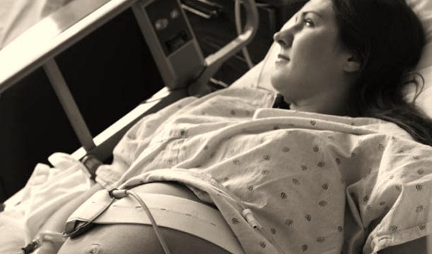
Events of Late Pregnancy
Notes:
As you get closer to your due date, your body and your baby are experiencing many changes. You and your partner may also feel anxious about your labour and delivery and think about what life will be like with your new baby.
Some of the common changes to the pregnant woman during the last weeks of pregnancy include:
Increased production of colostrum (mother’s first milk).
Increased frequency of practice contractions (Braxton-Hicks, pre-labour contractions).
Pelvic joints relax in preparation for labour and birth.
Increased cervical mucous (vaginal discharge).
Engagement of baby.
Nesting behaviour in some women.
Loss of mucus plug.
Some of changes to the baby include:
His lungs mature.
He puts on weight which helps him to regulate his temperature.
His immune system matures as mother’s antibodies are transferred through the placenta.

Slide 6
Natasha and Michael
Notes:
Read the following story:
Natasha wakes up at 5:00 a.m. with lower back discomfort. She goes to the bathroom and notices bloody vaginal discharge. She decides to go back to sleep. At 7:30 a.m. she wakes up with some abdominal tightening that feels like mild menstrual cramps. She wakes up Michael and asks if they should go to the hospital. Michael times her contractions, which are 30 seconds long and 15 minutes apart, and they decide to wait until the contractions are longer, stronger, and closer together. Michael decides to stay home from work to provide support and comfort. He prepares a light breakfast while Natasha watches Canada A.M. At 2:00 p.m. Natasha can no longer walk or talk through her contractions and they decide to head to the hospital.
Points to highlight related to the scenario:
Signs of true labour (dull backache, bloody show, regular contractions, increasing frequency of contractions).
Support (partner stays home from work, prepares breakfast, times contractions, provides emotional support).
When to go to the hospital (she can no longer walk or talk through a contraction or she can no longer be distracted through her contraction).

Slide 7
Am I Really in Labour?
False/Pre-Labour | True Labour
Contractions are irregular and do not become stronger | Contractions get longer, stronger, and closer over time
Contractions are felt in the abdomen | Contractions may be felt in the lower back and radiate to the abdomen
Change in position may relieve discomfort | Change in position does not provide relief and may increase discomfort
No rupture of membranes | Membranes rupture
No bloody show | Bloody show usually present
Cervix is not dilated or effaced | Cervix is dilated and effaced
Notes:
Suggested Activity: True vs. False/Pre-Labour Game
This will help participants learn the difference between true and false/pre-labour.
Materials needed:
Flip chart, blackboard, or whiteboard.
12 individual cards listing each signs of true or false labour.
Tape.
Instructions:
Using a flipchart or blackboard write the headings ‘True Labour’ and ‘False Labour’. Provide each couple with a card that has one of the 12 signs of labour as listed in the chart above. Have participants tape their card under the appropriate heading. Review the difference between true vs. false labour.
(Source: with permission from Wellington-Dufferin -Guelph Health Unit, Reproductive Health Manual, Class #4, 2003)
Variation:
A variation of this activity is to have different scenarios describing the signs of either pre-labour or true labour. Have participants identify whether the signs could be pre-labour or true labour. The facilitator can highlight points that were not mentioned by participants.

Slide 8
Am I Really in Labour?
Notes:
Early labour can be very long lasting even 24 hours before active labour begins. The average time of active labour for first time mothers is 12-14 hours. Subsequent deliveries are usually shorter. Remember that each labour is different and that are just averages.
False labour contractions may also be called Braxton-Hicks, practice, or pre-labour contractions.
Many women do not have contractions in their lower back. Often early contractions occur over the pubic bone and may radiate to the back, if they radiate at all.
Only 8-12% of women’s membranes spontaneously rupture prior to labour, but most women’s will not break until they are in active labour. If a woman’s “bag of waters” breaks it is important to note time, whether it was a leak or a gush, colour, and odour.
Keep in mind that labour for a second baby may be very different (generally faster).

Slide 9
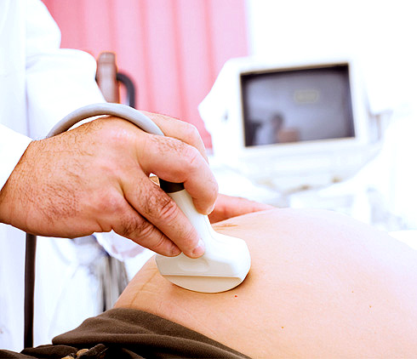
What is Preterm Labour?
Notes:
Provide the pregnant women with a copy of Preterm Labour Signs & Symptoms.
Preterm (premature) labour is labour that starts before 37 completed weeks of pregnancy. One in every thirteen babies in Canada is born before 37 weeks of pregnancy.
It is not always easy for a woman to tell if she is having preterm labour. Many of the signs of preterm labour can feel the same as some of the normal things that happen in the second half of pregnancy. There are important signs to watch for, especially if they are new or different than before. Partners can help by knowing the signs of preterm labour and what to do if it happens.
Signs and symptoms of preterm labour include:
Bad cramps or stomach pains that don’t go away.
Trickle or gush of fluid or bleeding from your vagina.
Lower back pain/pressure, or a change in lower backache.
A feeling that the baby is pushing down.
Contractions, or change in the strength or number of them.
An increase in the amount of vaginal discharge.
Some women may just feel that “something is not right”.
If you have any of these symptoms, go to the hospital right way to be assessed by a doctor or midwife. Tests and monitoring may be required. If you have a midwife, page her first so that she can meet you at the hospital.

Slide 10
What is Preterm Labour?
Notes:
What may happen at this point?
If there are no changes or small changes to the cervix, the pregnant woman may be sent home and monitored by her own care provider.
If she has started to efface and dilate, she may be admitted to a hospital that provides care for preterm babies.
If she is less than 34 weeks pregnant, the pregnant woman may receive two doses of a medication that helps the baby’s lungs mature.
In some cases, the pregnant woman may be transferred another hospital that can provide the level of care required for her pregnancy.
Labour may stop on its own or it may be delayed for a short time only. Even a little bit of time will help the baby to grow and mature and become more ready for birth.
Reference booklet: Preterm Labour Signs & Symptoms, Best Start Resource Centre, 2010.

Slide 11
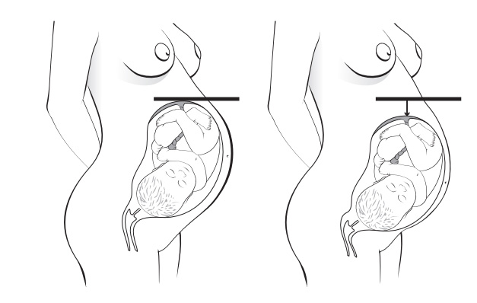
Your Baby’s Journey
Notes:
Suggested Activity: Lifesaver - Part One
The purpose of this activity is to illustrate the process of cervical effacement and dilation. Offer all participants a lifesaver (have a sugar-free variety also available). Instruct them to suck on the candy (do not bite or chew). As a guideline for timing, it is helpful if the facilitator also participates by having a candy. The candy should not dissolve completely prior to the end of this discussion.
Continue to present information on this slide.
Use the Knitted Uterus and the Fetal Model to demonstrate cervical effacement and dilation and what occurs during a contraction (www.childbirthgraphics.com). When the uterus contracts (tightens and relaxes), it allows the cervix to open and helps the baby move down the birth canal.
Use the pelvic model and fetal model to demonstrate cardinal movements and the process of birth (www.childbirthgraphics.com). At the end of pregnancy, the baby usually assumes a head down position facing the mother’s side.
(see next slide notes for continuation)
Note: Alternatively, you can also use plasticine to show effacement and dilatation. Thin out a ball of plasticine and show 50%, 70% and 100% effacement. Then put a hole in the middle and make it larger and larger, showing dilatation.
11

Slide 12
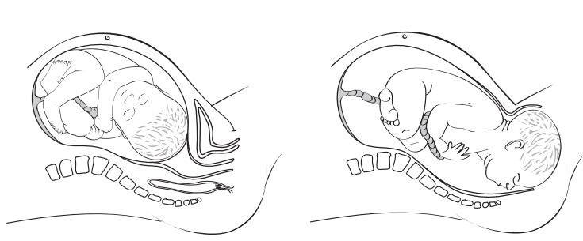
Your Baby’s Journey
Notes:
During labour, the following sequence of steps occur:
Engagement (lightening or dropping) - The baby moves deeper into the pelvis (0 station). The pregnant woman may find it easier to breathe and eat, as there is less pressure on the diaphragm. There is more pressure on the urinary bladder which may increase the urge to urinate.
Descent - The baby continues to move through the pelvis.
Flexion - During descent, the baby’s head presses against the pelvic floor muscles, which causes the baby’s chin to meet his chest. The smallest part of the head lines up with the lower pelvis.
Internal Rotation - The baby turns internally to face the mother’s back.
Extension - As the mother pushes, the head extends over the pubic arch toward the vaginal opening. The baby’s head is born.
External Rotation - The head turns to the side, which aligns the shoulders internally with the widest part of the lower pelvis.
Expulsion - Following the delivery of the shoulders, the baby is born.
Depending on the size of the class, refer to Childbirth Graphics poster on cardinal movements.
Refer to “Teaching Effectively with Visual Aids” by Childbirth Graphics, 1993 for detailed instructions about using the models. Posters may also be used to describe the labour and birth process.
Lifesaver Activity - Part Two:
Ask participants to compare the size and shape of the lifesaver from when they started to now. At the start of the exercise, the Lifesaver was thick with a small centre, similar to the cervix, which is thick and not-dilated at the start of labour.
By the end of the exercise, the Lifesaver is thinner and the centre is larger, just like the cervix that has effaced and dilated.

Slide 13
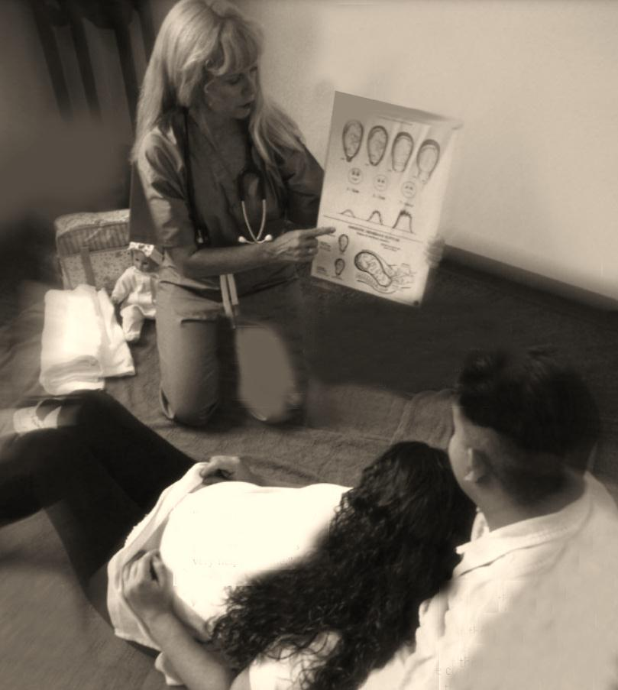
Stages of Labour
Notes:
Active labour typically takes between 12-14 hours in a first time mother, but the entire process may take much longer. Before labour actually begins, your body has already started to prepare for the transition of being pregnant to giving birth to your new baby. During the last weeks of pregnancy your cervix starts to ripen and efface and you experience more Braxton-Hicks contractions.
There are four stages of labour:
Stage 1 begins with the first contractions, when they become regular. It ends when your cervix is fully open (dilated) at 10 centimetres.
Stage 2 begins when your cervix is fully open (dilated) and ends when your baby is born.
Stage 3 begins after the baby is born and ends when the placenta is delivered.
Stage 4 is the immediate time after the birth, during which the mother’s condition is stabilized following the delivery—any complications for the mother are addressed at this time.
(Taken from Healthy Beginnings, 4th Edition, p. 129)
13

Slide 14
First Stage of Labour
Phase of labour | Cervical dilation | Length of contractions | Time between contractions
Early or latent | 0-3 cm | 30-45 seconds | 5-10 minutes
Active | 3-8 cm | 45-60 seconds | 3-5 minutes
Transition | 8-10 cm | 60-90 seconds | 2-3 minutes
Notes:
The first stage of labour usually lasts the longest. This stage is further divided into three parts:
In early labour contractions are far apart, short in duration, and less intense than they will be later on. During this phase the cervix becomes fully effaced and dilates from 0 to 3 cm. The pregnant woman may feel excited and nervous as true labour begins. This phase may last for days. If all is going well, it is best to avoid medical intervention at this stage. Labour time only starts in the next “active” phase.
In active labour contractions start to come closer together, lasts longer, and become more intense, but, manageable. During this phase the cervix continues to thin and dilate to 8 cm. The pregnant woman may feel tired and anxious. She may experience some back pain from the pressure of the baby’s head sitting in the pelvis.
The transition phase marks the end of the first stage of labour. Contractions come every 2-3 minutes and last 60-90 seconds. The cervix dilates fully to 10 cm and the baby starts to descend into the birth canal. The pregnant woman feels restless, irritable, and is overwhelmed by intensity of this stage. During this phase labour is transiting from stage one (effacement and dilatation) to stage two (pushing).
14

Slide 15
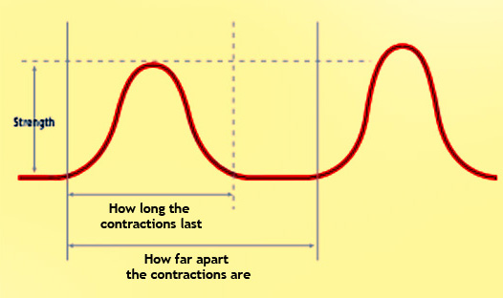
Timing Contractions
Notes:
How to time a contraction:
Use a clock or watch with a second hand. To find out how long the contraction lasts, start timing from the beginning of the contraction to the end of the same contraction. To find out how far apart contractions are, time the beginning of one contraction to the beginning of the NEXT contraction.
Have your partner write down:
When each contraction begins and ends.
How far apart the contractions are.
How long each contraction lasts.
How strong the contractions feel.
It is not necessary to time every contraction in early labour. Have your partner start timing the contractions for one hour to determine how far apart they are (i.e., every 10 minutes). Wait until you experience a noticeable change in your contractions or demeanour and time the contractions again.
15

Slide 16
When to Go to the Hospital
Notes:
Every hospital and health care provider will have their own version of when to go to the hospital. Your health care provider will provide guidelines about when to go to hospital or birthing centre. Generally, it is recommended that you head to the hospital or birthing centre when:
Your water breaks in a gush or is leaking steadily.
Your contractions are regular and 5 minutes apart and the hospital is less than 30 minutes away.
Your contractions are regular and 10 minutes apart and the hospital is more than 30 minutes away.
If you are not sure about what to do call the labour unit at the hospital or birthing centre or contact your health care provider. Discuss details of when to contact your midwife if you are having a home birth.
Consider using the 5-1-1 rule if this is your first baby: “Your contractions are intense enough to require you to focus and breathe rhythmically and are 5 minutes apart, each lasting at least 1 minute for a period of 1 hour.” (Penny Simkin, 4th Edition Pregnancy Childbirth and the Newborn. Pg. 244).
If this is not your first baby, your health care provider may suggest that you go to the hospital or birthing centre as soon as your contractions are 5 minutes apart.
Suggested Activity:
Refer to the Labour Decision Tree handout developed M. Sheedy, RN, BNSc, February 2010 (in Module Outline). Provide each couple with a copy of the handout and review points.
16

Slide 17
Notes:
View a video about labour and delivery such as:
Works of Wonder – The Miracle Within. Vida Health Communication Inc. 2000.
Understanding Birth - Chapter Two - Understanding Labour, 2nd edition. InJoy Birth & Parenting Education. 2010.
The Stages of Labour, 2nd edition. InJoy Birth & Parenting Education. 2006.
In many cases, you will find that it is probably better to show a portion of the video and then to have a discussion.
Discuss any questions or concerns that participants have following the video. Provide participants with some points to look for during the video:
What changes did you note in the pregnant woman’s emotions during labour?
What coping measures did she use?
What strategies did the support person use to help the pregnant woman?
17

Slide 18
For More Information
Health care provider
Local hospital or birth centre
Certified Doula
Public health department
The Society of Obstetricians and Gynaecologists - www.sogc.org
Notes:
18

Slide 19
This Best Start Resource Centre teaching tool
was developed with input from a wide range
of individuals from these organizations

Slide 20
The information represents the
best practice guidelines at the time of publication.
The content is not officially endorsed by the Government of Ontario.
Consult your health care provider for information specific to your pregnancy.
This document has been prepared with funds provided by the Government of Ontario
www.beststart.org
© 2011

